Slide 1
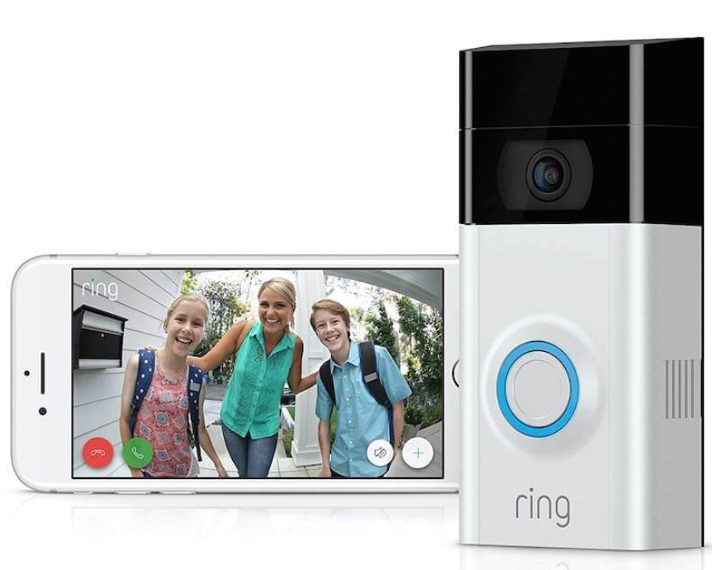
Hello Doorbell “Aapka Rakshak”
HELLO DOORBELL
SAGAR PATEL
HIRA RAZA
PRIYANKA PRAKASH BABU
PENGHUI WU
PRATEEK NAYAN
NIKITA PATIL
HELLO DOORBELL
Notes:
Hello everyone. I am Sagar Patel and my other team members are Hira Raza, Priyanka Prakash Babu, Penghui Wu, Prateek Nayan and Nikita Patil. We will be presenting on a product called Hello Doorbell. This product is owned by the company Ring and comes with the name Ring video doorbell. Ring is a company with a mission to create products that help people protect their homes and neighborhoods. We will launch this product in India with the name Hello Doorbell and with the tagline “Apka Rakshak”. The tagline is in Hindi which translates to “Your protector” in English. We have made kept the tagline in Hindi to reach out the regional target audience and will discuss this later on in the upcoming slides.Next slide

Slide 2
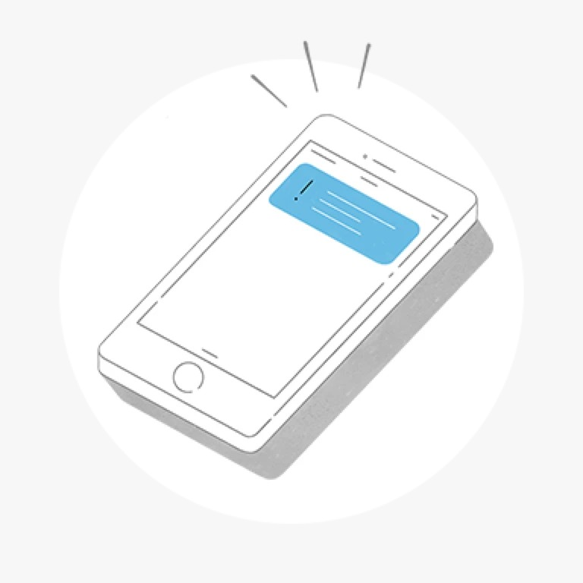

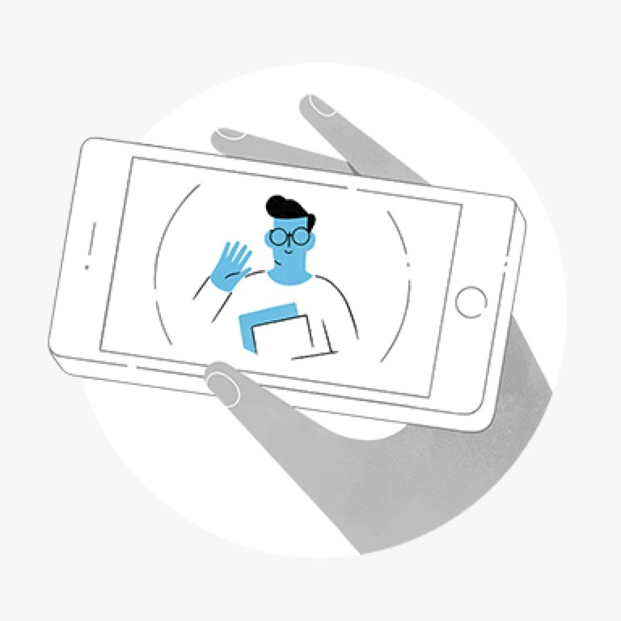
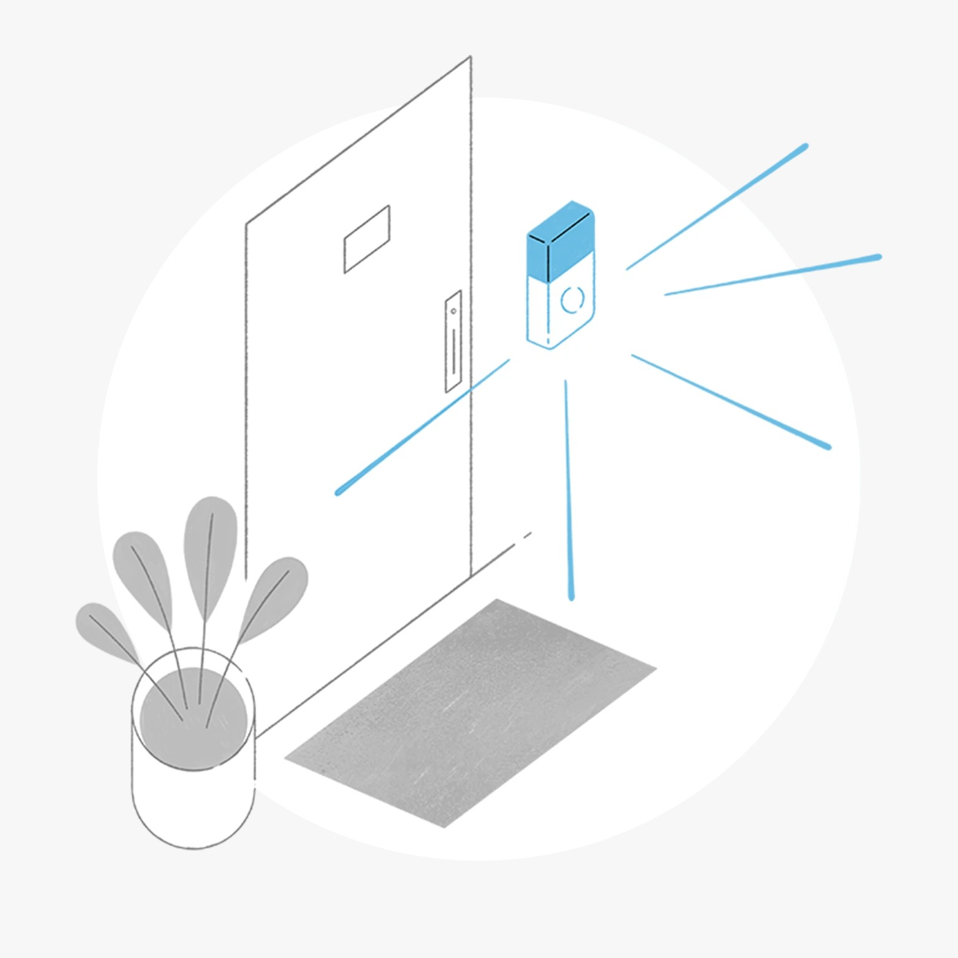
HELLO DOORBELL - INTRODUCTION
Receive alerts on phone, pc, tablet
A type of smart doorbell that lets a user see, hear and speak to visitors in real time from anywhere
Monitor property with on demand audio and video
Detects motion when people visit. Customized motion zones cab be set in spots which seem to be more vulnerable
Notes:
Let us have an overview of the product.Hello doorbell is a type of smart doorbell. A smart doorbell is nothing but an improvised version of day-to-day audio doorbells. Hello doorbell lets a user see, hear and speak to visitors in real time from anywhere. It has an attached camera which can record or live stream the actions that are happening in front of it. It is connected near the front door of the home; which is generally the place that needs the most security.Few of the best features of this doorbell are –1. Security alerts : Alerts are delivered at phone, tablet and PC whenever anyone presses the doorbell or triggers the built in motion sensors2. Monitor property : We can monitor our property in HD video and check on our home at anytime with on demand video and audio.3. Detect motion : When people visit our property we can come to know about that by motion sensors of this doorbell.

Slide 3
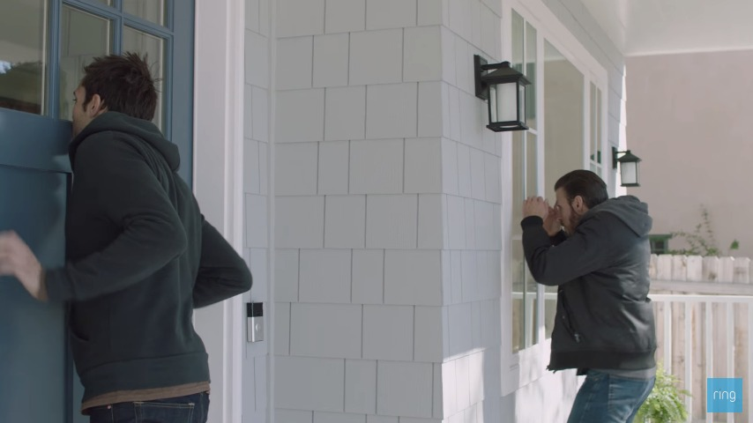
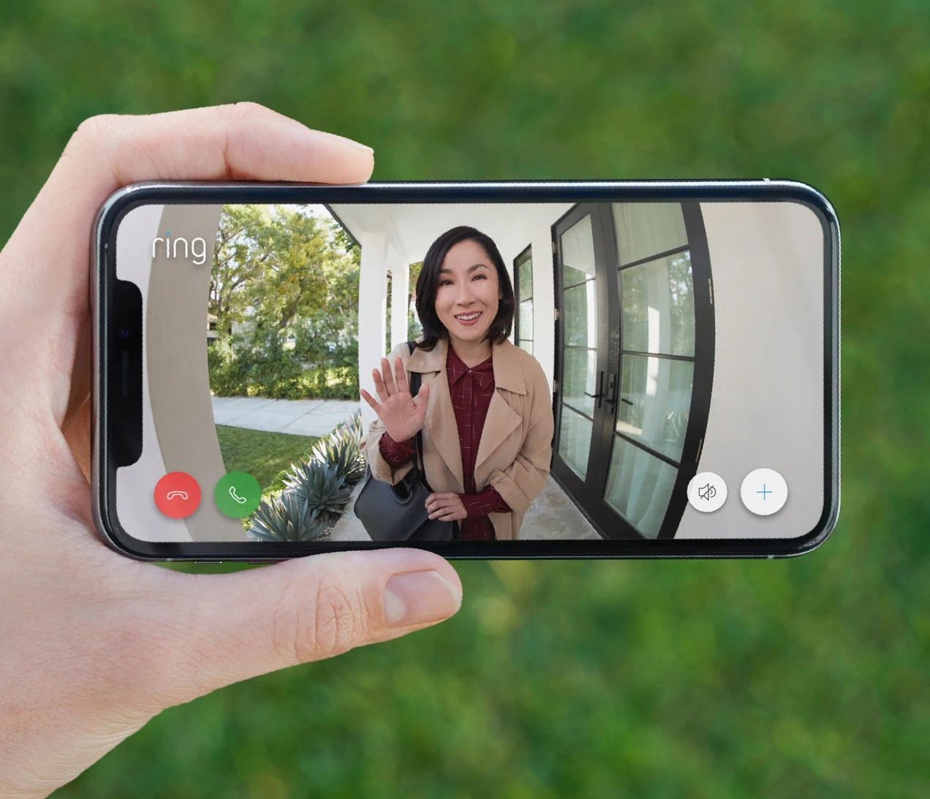
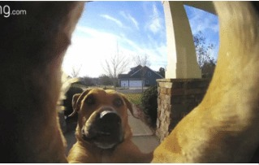
Problem statement
Rising crimes, thefts, robberies
Need for security devices
Delhi, in 2018, reported around 1200 cases per 100,000 people. This number was four times higher than any other metropolitan cities of India
Preventing thefts and crimes
Keep an eye on kids and pets playing outside
Answer friends, family and Delivery Man Remotely
Notes:
Few of the best uses of ring doorbell includes-1. Security – To reduce the chances of a crimes, thefts, burglaries, this device is quite reliable. The hidden camera installed in the doorbell isn’t that visible, so that would be a definite miss by any robber who isn’t aware of new security technologies. If we think that some zone at the front door is more vulnerable then we can add more security at that place by marking that distance to be covered in the motion sensing zone. So that any activity in that part will be detected.2. Answering people remotely – At times when we are not at home, and suppose any of our family member or friends visit our house then we can answer them remotely. This feature of easy communication is also helpful to give a reply to the package delivery man.3. Keeping eye on kids and pets - When they are playing outside, or in the front yard portion of house, we can stay rest assured of their safety. As we have already become familiar with this product, let us dive further more for the problem statement. One of the best purpose that Hello doorbell solves is to reduce the chances of thefts and robberies as already mentioned earlier. Keeping that point in mind and to help people overcome the problems they are facing, we are going further with marketing this product. We are selecting the territory of Delhi for launching this product in India. One of the reasons being, the crime rate in Delhi was around 1200 cases per 100,000 people, which is 4 times more than other metropolitan cities of India. Rising crimes leads to rise in need of security.
My colleague Hira will take the presentation further on to talk about the potential customers of our product

Slide 4

Potential Customers
Wide range of customers
Delhi’s population is rapidly growing every year--Family dynamic
Residential areas
Greater Kailash, South Extension, Defense Colony
Parent’s who are at work while children are home
Notes:
There is a wide range of potential customers based on our product. We are launching our product in Delhi and their population is rapidly growing every year which means their family is dynamic and no of household is also increasing. We will be focusing on residential areas, some of the residential areas we will be focusing on are middle to upper class areas that can afford our product
A few examples of residential areas are Greater Kailash, South Extension, Defense Colony.
- Also, this is a product for working parents who would want to take care of their children, pet, who are at home, With this product the parents feel safer by knowing who will be visiting the house.

Slide 5
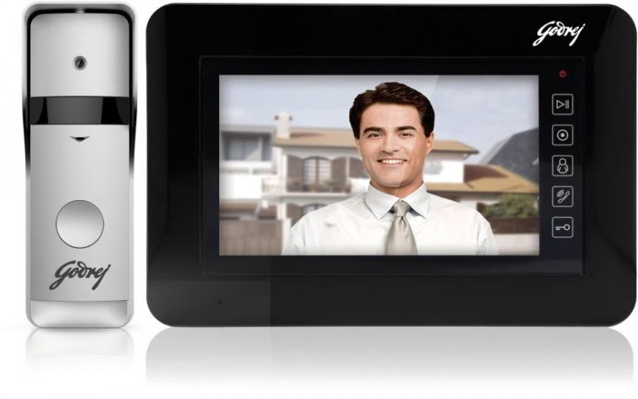
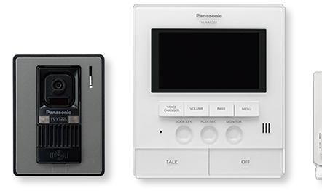
Competition
Godrej Solus ST 7 LITE Video Door Phone
Panasonic VL-SW251BX Video Door Phone
Notes:
With anything there will be competition
India has access to other video doorbells. One of the competitor is :
-Godrej Solus ST 7 Lite Video Door Phone: It lets you know who’s there at the door without having to open it. This can be a threat to our product since our product doesn’t allow the unlocking door without attending it.
It can connect to up to 2 Outdoor units, 2 CCTV cameras, 1 master monitor + 3 slave monitors, and 1 CCTV output. It also supports 1 channel output relay to open the slide gate. This doorbell is Vandal Resistant and Weatherproof. You can check all notifications on your smartphone while you out and on your TV when you are watching it.
-water and dust resistance
Another competitor is: -Panasonic VL-SW251BX Video Door Phone can connect up to 4 wireless monitors and you can do intercom call between them – meaning that there is both way video call. It supports night vision and voice changer. With 0.3 MP camera, it can record a maximum 50 events or 400 images. These products are already launched in India and can be a potential threat.

Slide 6
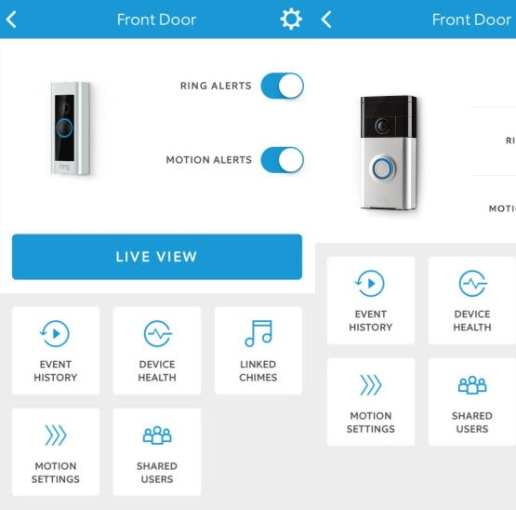
Assumptions
Established company (Founded in 2012)
Sales are rapidly growing
Advanced technology
Private surveillance network
No privacy
Surveillance concerns
Threaten civil liberties
Notes:
A few of the assumptions for our product is
It is an Established company (Founded in 2012)
Sales are rapidly growing ever since then - The doorbell has not changed since it was invented in 1880, until recently in the last 8 years. So this Advanced technology will definitely attract lot of customers
A few of the assumptions that users may have for our product to not buy are
There feel they may Not have privacy ,
They feel there may be Surveillance concerns
There is a threat to civil liberties based on assumptions that police is using to tap these doorbells or anybody can tap into through wifi, these are the major concerns for potential customers

Slide 7
SEGMENTATION
Geographic Segmentation :
Based on the crime rates in different states in India, population density
Demographic Segmentation :
Based on the income of the families, type of residence
Psychographic Segmentation :
By conducting interviews
Based on surveys conducted about crime rate.
Based on customer data
Behavioral Segmentation :
Based on benefits sought by customers, usage level.
Notes:
Market segmentation is becoming an increasingly important issue in market research and business intelligence in India. Segmentation, as defined in market reports by the Market Research Company India, helps companies identify and pin point the market into groups of potential customers with similar motivations and characteristics. By segmenting out certain markets it makes marketing in this growing economy far more productive and profitable. For our product, we are considering the following segments:
Geographic Segmentation : We will be segmenting regions based on the crime rates in different states of India and also population density,
Demographic Segmentation : For demographic segmentation, we will be considering different incomes of families and different types of residence.
Pyschographic Segmentation: we will be conducting -
Interviews: Interviewing working parents on the need of security for their children.
Surveys: Surveys will be conducted to understand which region/state has the highest crime rate
Customer data: we will collect data on most bought items in Delhi and decide on the category of the product. The Electronic items and household appliances are in top 20 most bought product categories in Delhi.
4. Behavioral Segmentation – Based on what customers need like good sound system, high resolution camera, ease of installation, basically the benefits sought by customers.

Slide 8
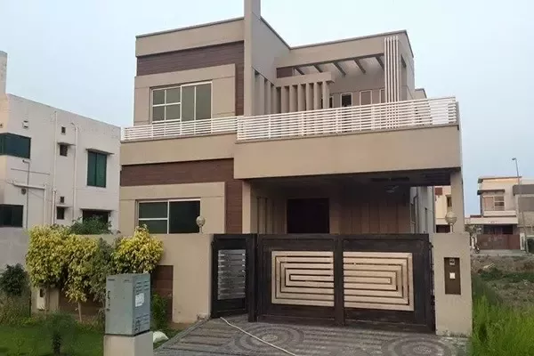
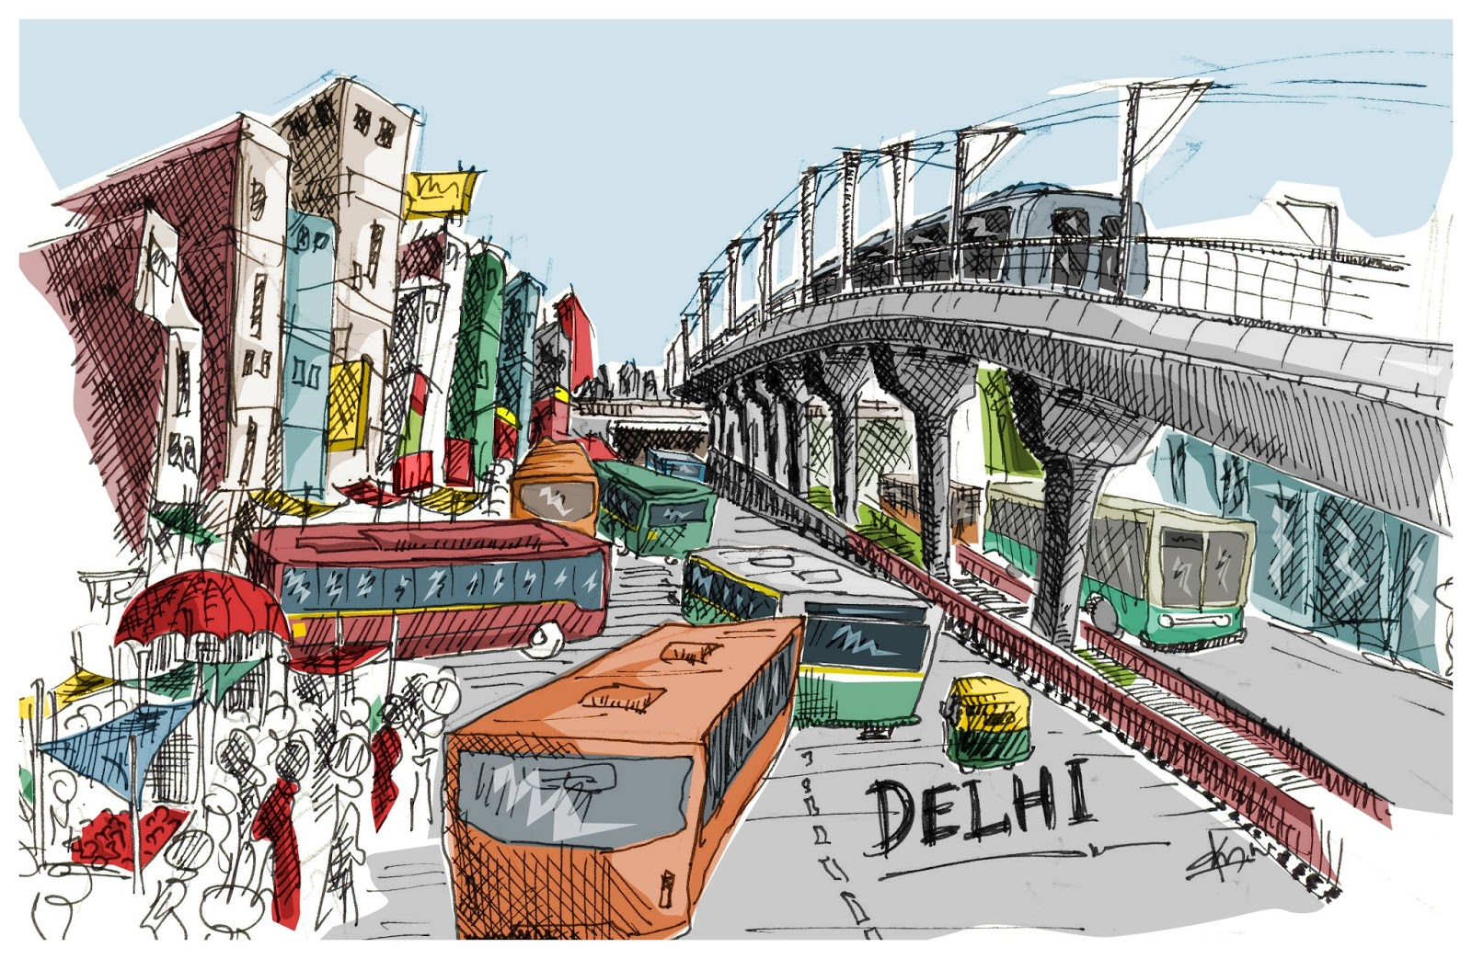
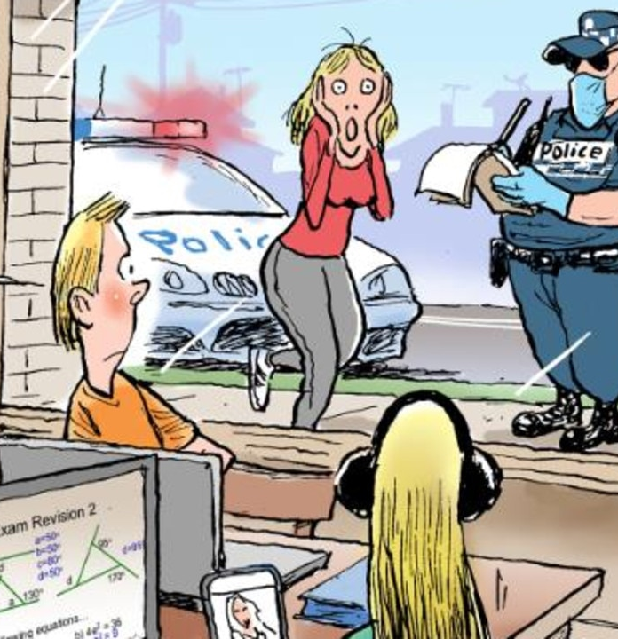
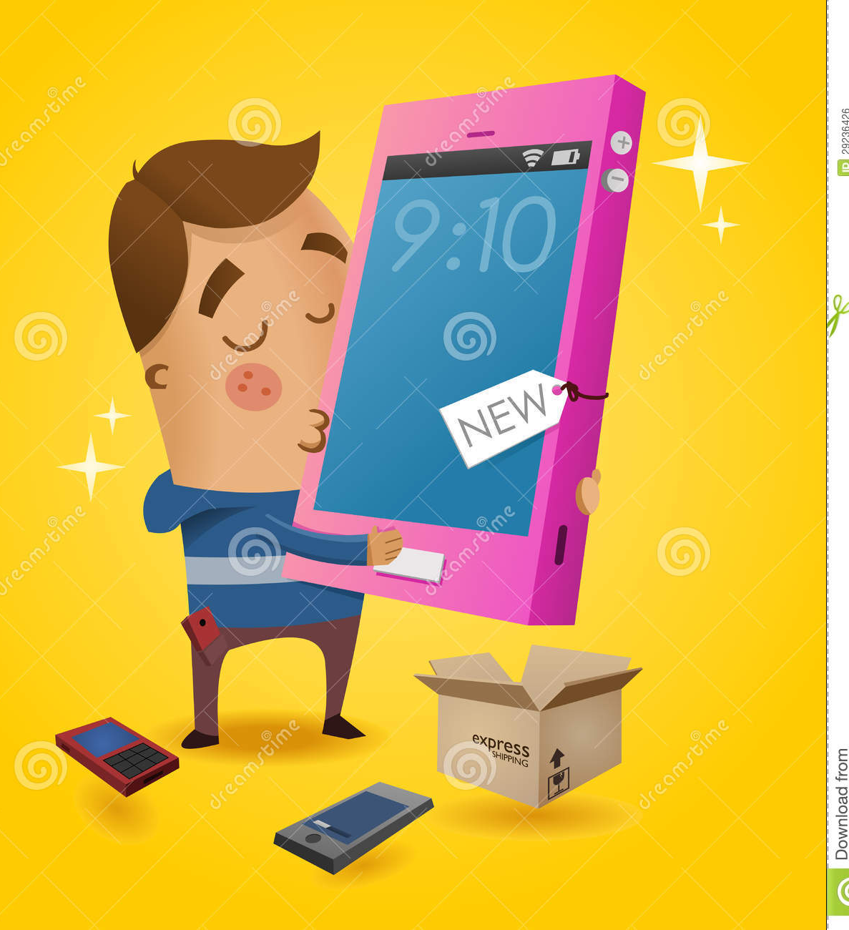
MARKET TARGETING
DELHI
What’s Mum Doing ?
Notes:
Market Targeting is required to evaluate the potential and commercial attractiveness of each segment.
For selecting the target market, we have considered the factors like Criteria Size: How large the market size is, does it justify segmenting
we have ensured to have measurable differences between segments.
Next factor is Money, Anticipated profits must exceed the costs of additional marketing plans and other changes.
How easily each segment is accessible to our team and if the segment is able to receive our marketing messages
Based on these factors, we have targeted Delhi – most densely populated state with highest crime rate of 67.87. In Delhi, we will also be concentrating on more densely populated cities like New Delhi, Kirari Suleman Nagar, Karawal Nagar, Sultan Pur Majra, Bhalswa Jahangir Pur.
Upper Middle class and Upper-Class- Elite families –Since this product is little on higher end we will be marketing it to Upper class families, families who need security, those who are working parents who need to keep a track on their kids and aged people back home. Parents can walk home immediately if they notice any suspicious activity going around while the kids are at home
Gadget lovers – Since this product is an app-based home appliance, which is driven by smart technology, the gadget-tech savvy people will like this product.

Slide 9
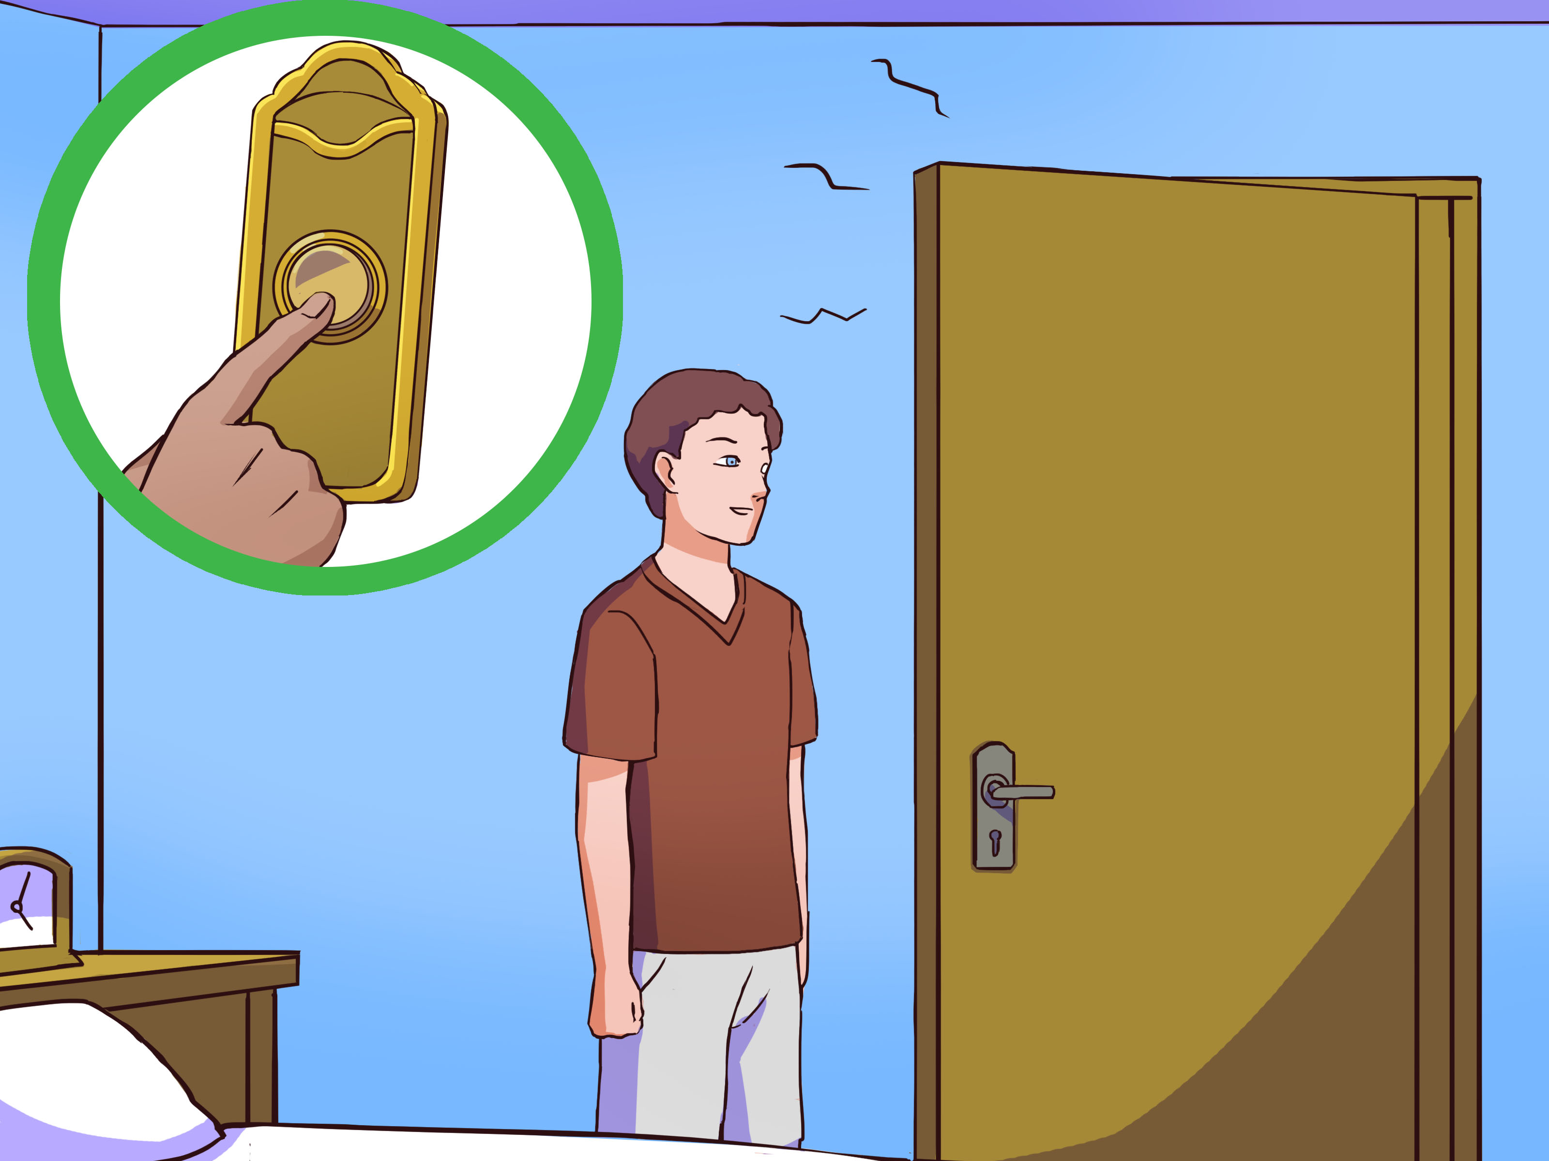
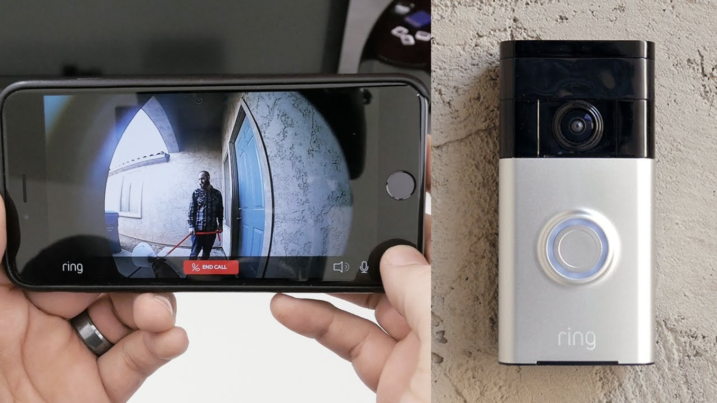
POSITIONING
Positioning the product – “Hello Doorbell” as smart device overcoming the traditional way of answering the doorbell.
Positioning the product for the upper middle-class families as a secure, bot-guard appliance.
After considering our competitors, we have improvised the features like camera resolution, 180° wide angle view and much better two-way communication to resolve the pain points faced using competitor device
“Neighborhood Watch” – Alerts neighbors about any suspicious activity.
Easy to install the device and use the application.
We provide not only live recording, but also recorded videos can be accessed at any point of time via micro SD card or recording in cloud
Easy Maintenance.
Who is it ?
Who is it ?
Who is it ?
Hello Doorbell
Notes:
After targeting the right market, doing competitor analysis and reviewing the differences between the various market segments, We position our product “Hello Doorbell” as a smart device overcoming the traditional way of answering the doorbell.
We are positioning the product as a secure, bot-guard electronic appliance.
After considering our competitors, we have improvised the features like better camera resolution, 180 deg wide angle view and better two-way communication to resolve the pain points faced using the competitors device
Another distinguished feature in our product is “Neighborhood Watch” – which can help in Alerting neighbors about any suspicious activity. – A feature in app to upload the videos , discuss and track any suspicious activities with other neighbors can help the customers to make their home safe and as well as the community.
It’s an Easy to install device and user friendly mobile application.
We provide not only live recording, but also recorded videos can be accessed at any point of time via micro SD card or via accessing the cloud storage.
And finally it’s a device which needs least maintenance .
So, based on the above-mentioned points we are positioning our product in the market.
That’s the end of our presentation. We are open to answering your questions.
Thankyou.

Slide 10
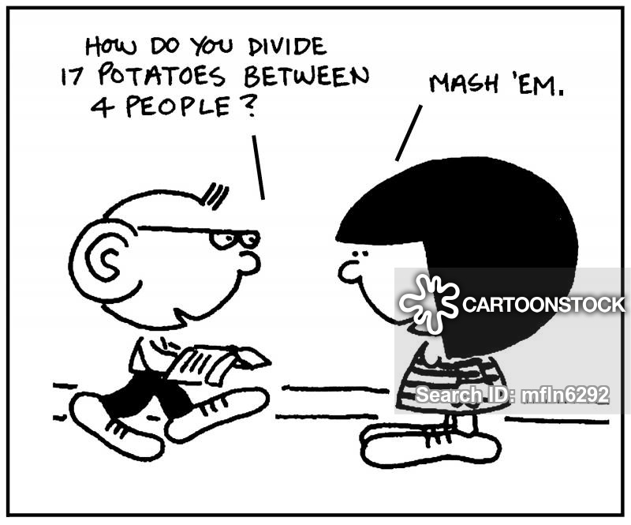
Price Per Unit
US Ring Video Bell Price: $ 99.99
US Household Income: $ 60,293
Price Income Rate = US Ring Video Bell Price / US Household Income = 0.1658%
Delhi Household Income: ₹ 731,058
Price Per Unit in Delhi= Delhi Household Income x Price Income Rate = ₹ 1,211.76
Notes:
The price of the most popular Ring Video Bell is about 100 dollars in US, US Household Income is about 60 thousand dollars, we use this two to get the price income rate, which is 0.1658%. Delhi Household Income is about 7 hundred 31 thousand rupees. And then, Delhi Household Income times Price Income Rate, we get the unit price in Delhi, which is about 12 hundred rupees.

Slide 11

Potential Market
Number of Household in Delhi: 4,205,000
Potential Market = (Number of Household in Delhi / 2) * Price Per Unit in Delhi
= ₹ 2,547,725,483 ( $ 33,286,197)
Notes:
Since the price is calculated based on median household income, we assume half of the families are our target consumers, so the number of household in Delhi, which is 4,205,000, divide 2, and then times Price in Delhi, we get the potential market value, which is about 33 million dollars.

Slide 12

Sales
Number of Household in US : 127,590,000
Annual Sales volume in US : 591,000
Number of Household in Delhi : 4,205,000
Annual Sales = (Annual Sales volume in US / Number of Household in US) * Number of Household in Delhi * Price Per Unit = ₹ 23,602,661
Notes:
the number of household in US is 128 million, annual sales volume in US is 591 thousand units, Number of household in Delhi is about 4 million. Let the annual sales volume in US divide the number of household in US, and then times number of household in Delhi, times Price in Delhi, we get the annual sales. It’s about 24 million rupees.

Slide 13


PROFITS
Estimated profit rate : 10%
Annual Profits = Annual Sales x Estimated profit rate
= ₹ 2,360,266
Notes:
since the company grow up rapidly, we assume the profit rate is 10%. Then the profit will be about 2 million rupees.

Slide 14
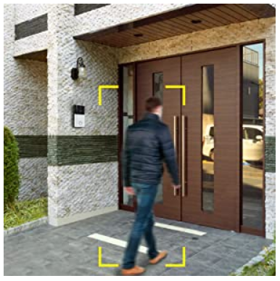
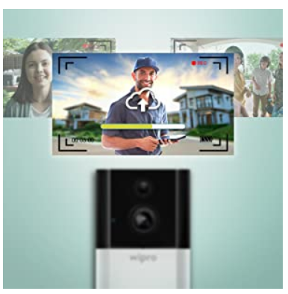
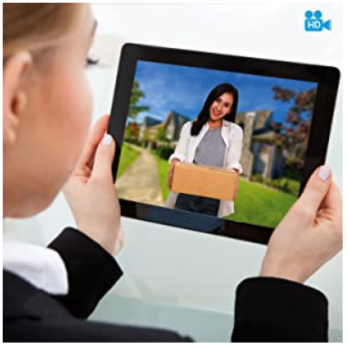
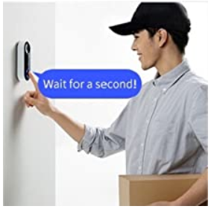
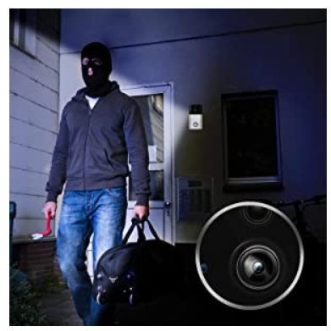
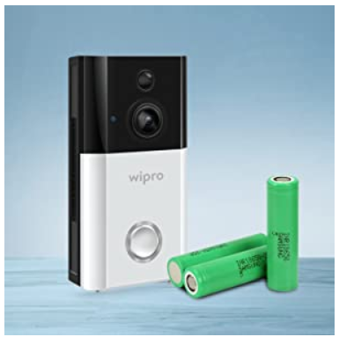
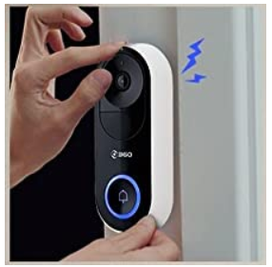
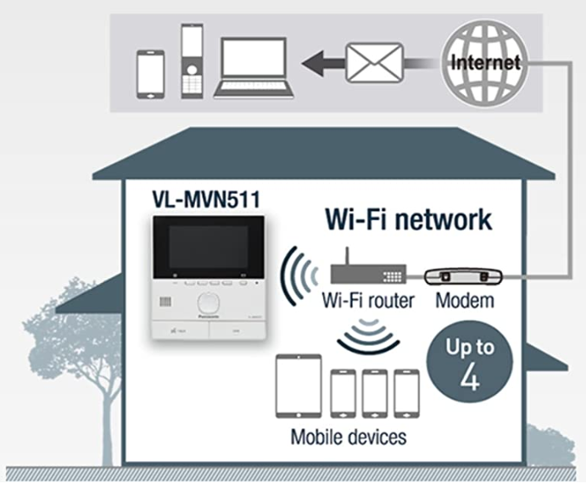
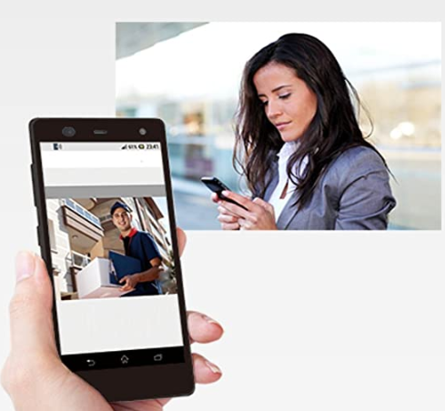
MARKETING PLAN - PRODUCT
Smart Security
Video Recording
Monitor your home remotely
Name of the Product
Hello DoorBell
Two- Way Audio
Night Vision
Easy maintenance
Violent Demolition Alarm
Wi-Fi Connection
E-mail Notification
Notes:
The product in US is known by Doorbot, since this product is marketed in India, to add a regional touch we have renamed the product as “Hello Doorbell”.
Features of the product are :
Smart Security : Inbuilt sensors in Smart doorbell give alerts on your phone when anyone is near to your door or if there is any suspicious activity near your door
Video Recording : On recording mode when not in home via micro SD card or recording in cloud.
Monitor Your Home Remotely : With 720p HD resolution camera with wide angle lens, View clear picture of your front door on-demand whenever you want.
Two Way Audio (Talk & Listen) : See, hear and talk to visitors through built-in 2 way audio enhanced microphone and speaker.
Night Vision : Monitor your home at night with the good visibility provided by Infrared LEDs.
Easy to Maintain with Removable Battery Pack : Charge your Doorbell without moving the device using the quick-release battery pack.
Violent Demolition Alarm : Even if the best device is placed to add protection, thieves always find a way out, most of the time they think to steal the device itself. To overcome this problem, a loud alarm will start to beep if the doorbell is illegally assembled.
Wi-Fi Connection : In addition to smartphones/tablets, the main monitor can also wirelessly connect to the Wi-Fi router for easy connections without a cable. Upto 4 devices can be connected.
E-mail Notification : The device will be able to send e-mail with a time image of visitors to e-mail addresses registered in advance, enabling users to check who has visited when you are outside home.

Slide 15

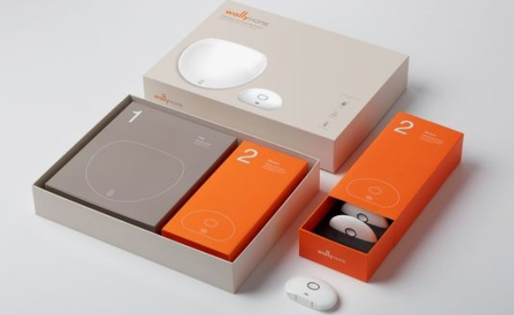
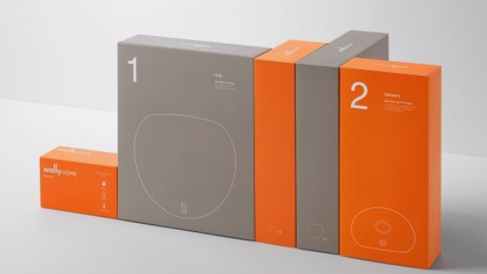
MARKTING PLAN - Packaging
Packaging Features:
The Box itself will act as an instructional guide for installation.
App installation guide
Notes:
Packaging Features:
The Box itself will act as an instructional guide for installation. The numbers on the sub boxes will indicate and guide the customer step by step on installation.
App installation guide will also be available inside the box assisting user in installing app on iOS or Android

Slide 16
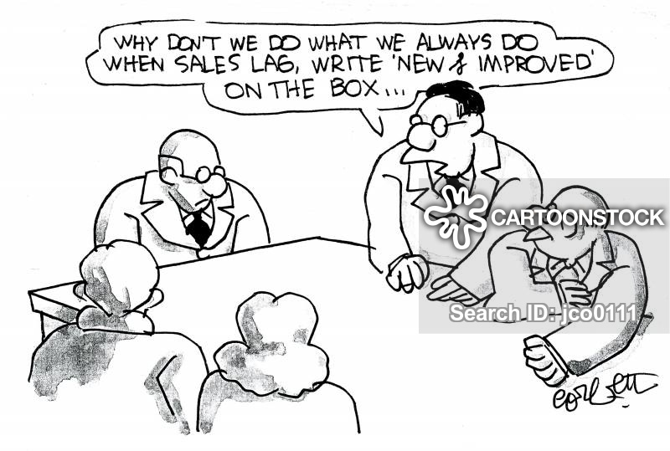
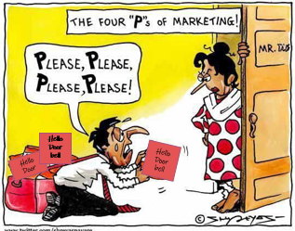


MARKETING PLAN - Promotion
Hello Doorbell – “Aapka rakshak”
Notes:
This product is for Indian Customers and is particularly concentrating Delhi population who speak Hindi. To add a personal message, our tag line is, Hello Doorbell – “Aapka rakshak”. Which means – Hello Doorbell – “Your Bodyguard”
For the Promotions, We will be using the Push and Pull Strategy.
As Part of Push Strategy, we will be sending out flyers, brochures, to every doorstep
As part of Pull Strategy, we will be promoting our product on Social media platforms like Facebook, Twitter, Instagram.
YouTube Video Ads and Google Ads will be made to attract more number of users to buy the product.
The installation videos will be made available on Youtube.
Free delivery for first 3 months

Slide 17

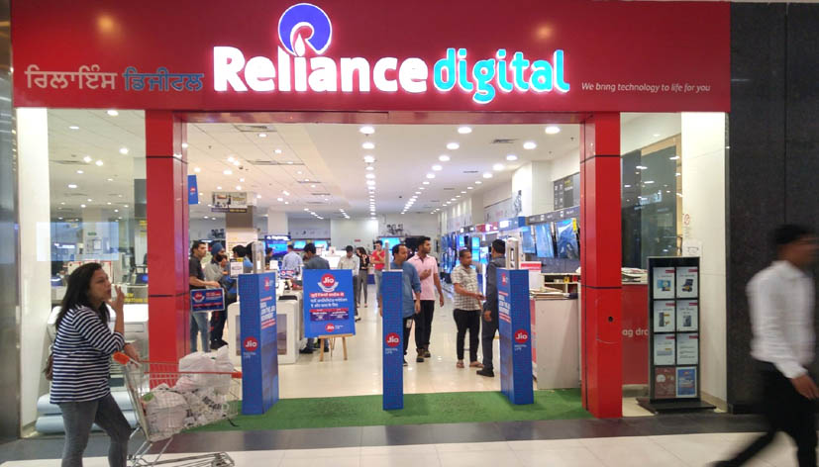
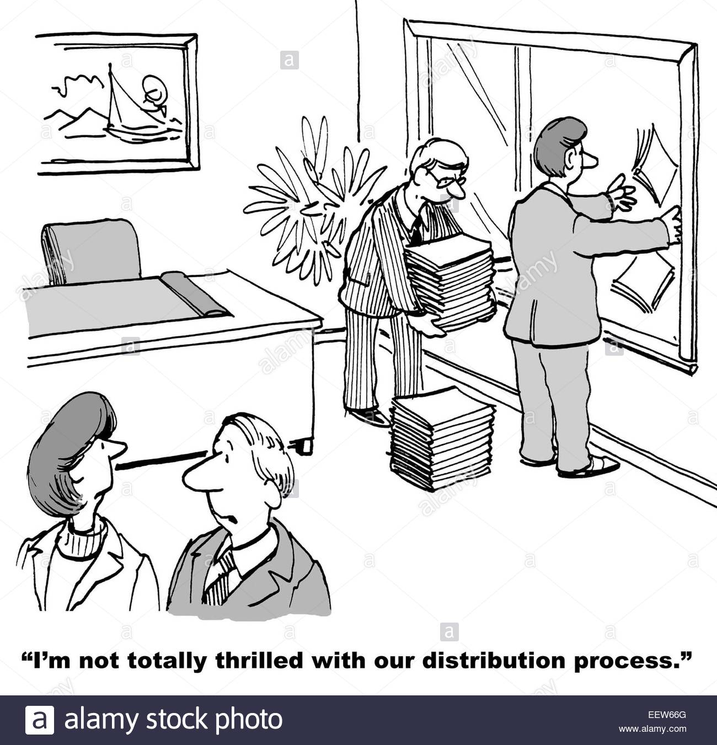

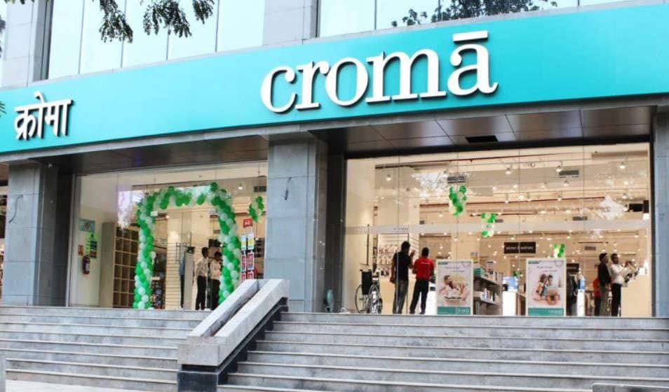

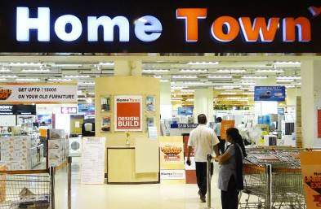

MARKETING PLAN - Distribution
Notes:
<showing the center picture> We are definitely not distributing our product this way :P
First, there will be a regional rollout. We are going to target delhi for that. For 3 months the device will be sold in tech stores like Reliance digital trends, croma and hometown.
After that we’ll fix our defects if any and then we’ll do the national rollout on the E-commerce websites like Amazon, Flipkart, Snapdeal, allowing the user to buy the product online.
The product will also be made available offline, at retail electronic stores.
Since the App is supported by iOS and Android, it will be made available by Google plays stores and Apple play stores.
Web based service will also be made available, orders will be taken from our website as well.

Slide 18

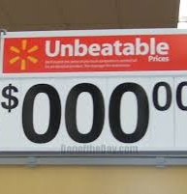
PRICING PLANS
PRICING | PRO | BASIC
BASE MODEL | 1211.76 INR | 1211.76 INR
SUBSCRIPTION COST | + 500 INR per month or 6000 INR per year | 1211.76 INR
TOTAL | 1,711.76 INR | 1211.76 INR
Notes:
We have come up with 2 pricing models for our product, the basic version and the pro version. The basic version offers only a video doorbell at a cost of 1211.76 Rs. With the Pro version the customers will be able to get a recording of 24 hours of Triggered activity with an additional cost of 500 rs.

Slide 19

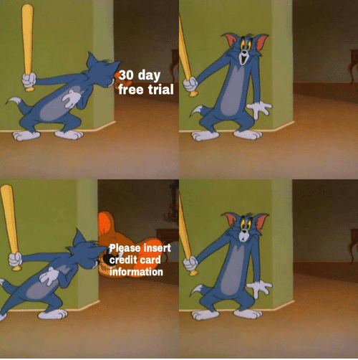
PRICING PLANS
We are providing flexible EMI options with 0 interest
Also, we are offering free trial to our Pro Plan for first month and you will be charged 500 INR per month once your free trial expires.
Notes:
We are providing Flexible EMI options and also a free one month trail period for our pro version.

Slide 20

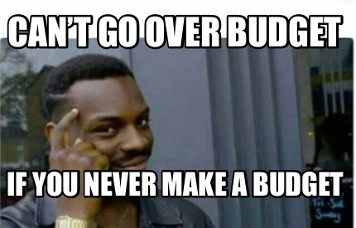
MARKETING COST
Type | Cost
Newspaper Advertisements | 2,16,000
Outdoor Advertisements | 1,50,000
Radio Advertisements | 2,39,400
Transit Medium Advertisements | 2,40,000
Digital Marketing Cost | 1,00,000
Total | 9,45,400
Notes:
Our marketing cost estimate is around 9 lkh 45 thousand and 400 rs. You can refer to the table for split up.

Slide 21


REGIONAL ROLLOUT
First to be launched in Delhi, the capital of India. (28 million and spread over 46,208 Sq. Km)
First 3 months we plan to offer a free delivery.
Take a feedback survey from customers and resolve issues if there are any during this period.
Notes:
We first plan to launch our product in Delhi. For the first 3 months we are planning to offer a free delivery for our product. WE are also planning to take a feedback survey from customers and resolve issues if any during this period.

Slide 22
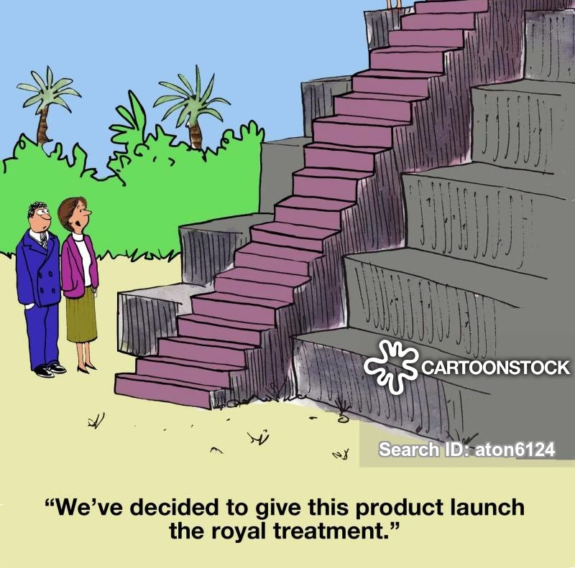
NATIONAL ROLLOUT
India video surveillance market is projected to grow at a CAGR of 22.7% during 2019-25.
Partner with any of the leading ecommerce websites like eBay or Flipkart for national rollout.
Option of pre ordering before the official rollout.
Notes:
Looking at the rate at which India’s video surveillance market is projected to grow in the upcoming years, we plan to partner with the leading ecommerce websites like flipkart and ebay for our national roll out. We also have the option of pre ordering the product before the official rollout

Slide 23

LIMITATIONS OR POTENTIAL THREATS
If a big company copies the product, we will be securing our product by having patents for our design and technology, by offering superior features, by building brand loyalty and trust; and by offering competitive prices.
Might be too expensive for the middle-class population.
May face threat from the rise in security camera market.
No unlocking by phone by tablet
Poor Internet connection can degrade the camera resolution
Notes:
So the last variable we will be addressing here is the potential threats and weaknesses.Some of the threats and issues we might face are as follow:Read the slides.

Slide 24


